Slide 1
Radioactivity Decay Laws, Activity and Equilibrium

Slide 2
Radioactive Decay
the radioactive decay rate constant, λ, is the probability, per unit time, dt, that a certain radioactive species will undergo spontaneous transformation (s⁻¹, min⁻¹, y⁻¹ etc.)
note: a nucleus has the same probability of decay, regardless of its age.
Law of Radioactive Decay:
A = λN

Slide 3
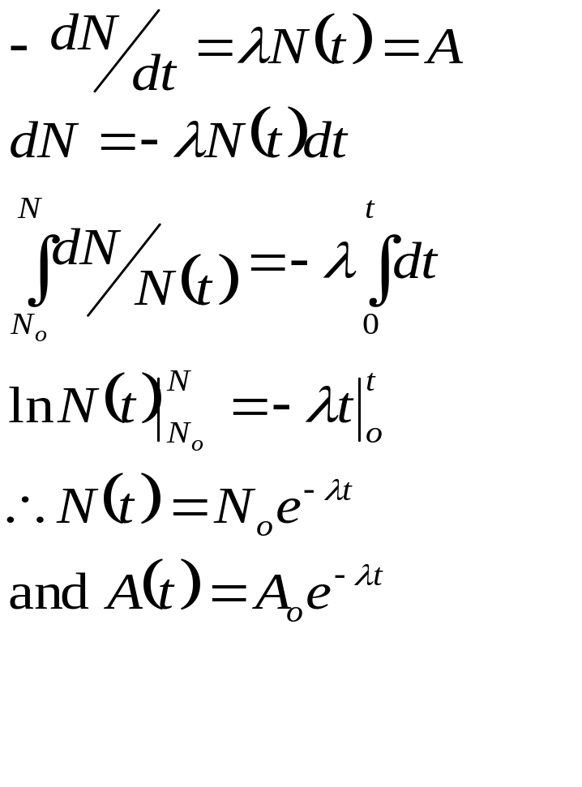
Law of Radioactive Decay
  let N equal the number of atoms present at time t
  let dN equal the number of atoms which decay between times t and t+dt

Slide 4
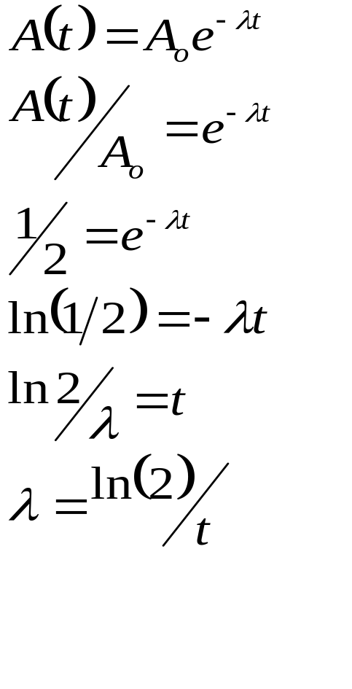
Half-Life (t_{1/2})
half-life, T_{1/2}, is that amount of time required for the activity of a sample to fall to one half of its initial value.
half-life is averaged over many atoms, i.e., it is a non-stochastic quantity.
note: always ensure that λ and the half-life have the same unit of time when performing your calculations.

Slide 5
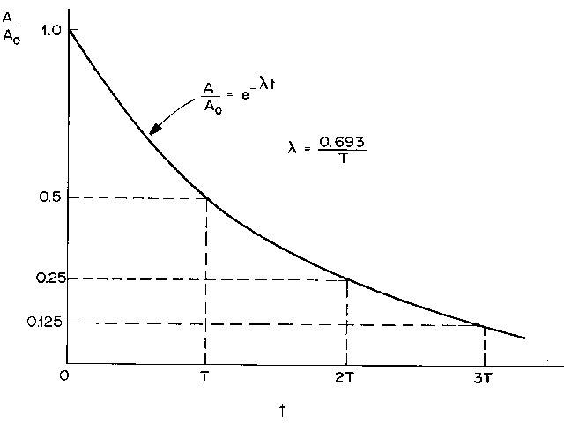
Radioactive Decay as
Function of Time

Slide 6
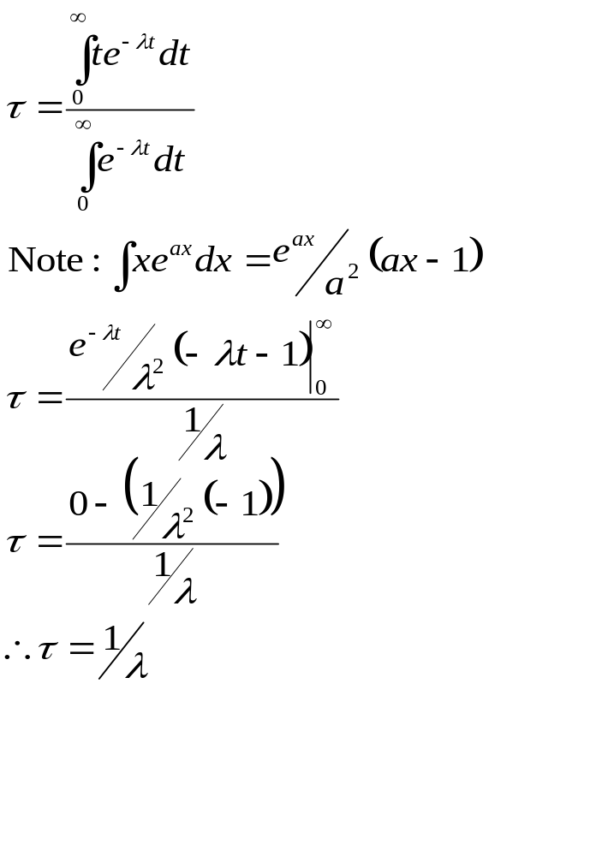
Average Life
Average life, τ, is the average of all the individual lifetimes experienced by atoms in a radioactive sample.
Let P(t) equal the probability that a particular atom has not yet undergone radioactive decay over a time interval 0 to t
P(t) = e^{-λt}

Slide 7
Units for Radioactivity
all of the fundamental quantities in physics have units that are familiar by now, e.g., gram, centimeter, second (cgs system) etc.
activity is the fundamental measure of the “amount” of radioactive material present.
the mass of material present is not of primary interest; however, the rate of radiation emission or radioactivity is important.

Slide 8
Units for Radioactivity
  the traditional unit of activity is the Curie (Ci), which corresponds to the transformation rate of one gram of radium, approximately 3.7E10 tps.
  the SI unit of activity is the Becquerel (Bq), which corresponds to one transformation per second (1Bq = 1dps=1tps).

Slide 9
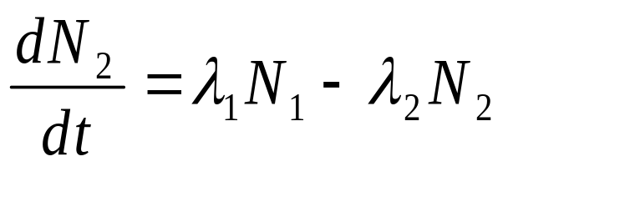
Parent Offspring Equilibria
consider that the radioactive decay (λ₁ - loss term of parent) of a sample of parent atoms is the production term for the offspring.
any subsequent decay of the offspring (λ₂) would result in an independent loss term for the offspring

Slide 10
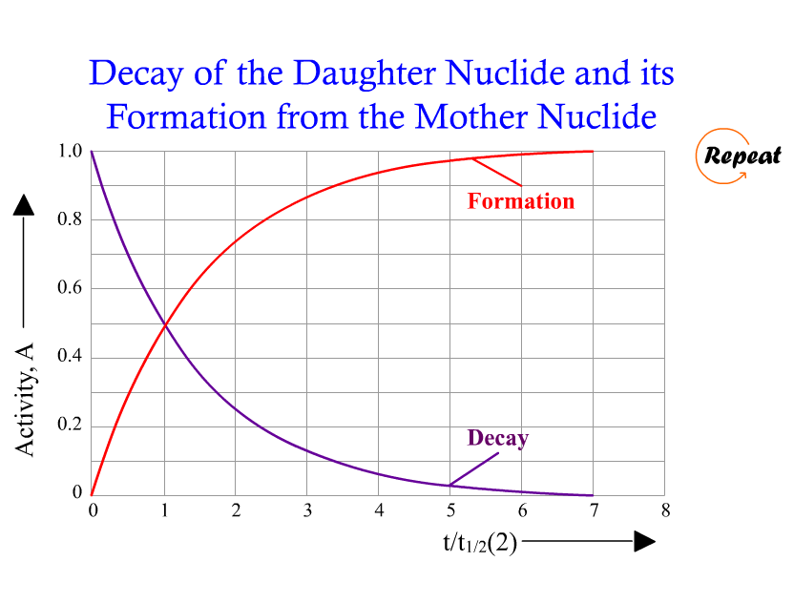

Slide 11
Secular Equilibrium
the first case to look at is when the parent is much longer-lived than the offspring.
λ₁ << λ₂
parent activity is constant over observation time
this equilibrium situation is referred to as secular equilibrium.
example: ²²⁶Ra to ²²²Rn

Slide 12
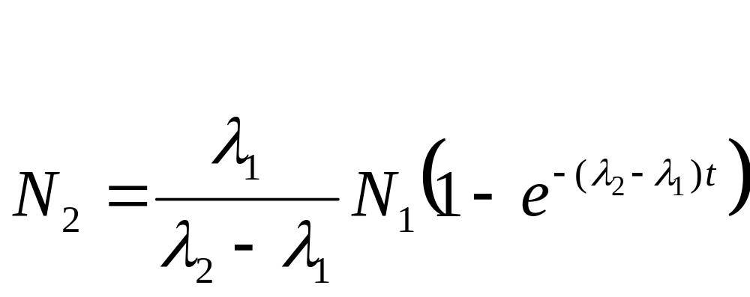
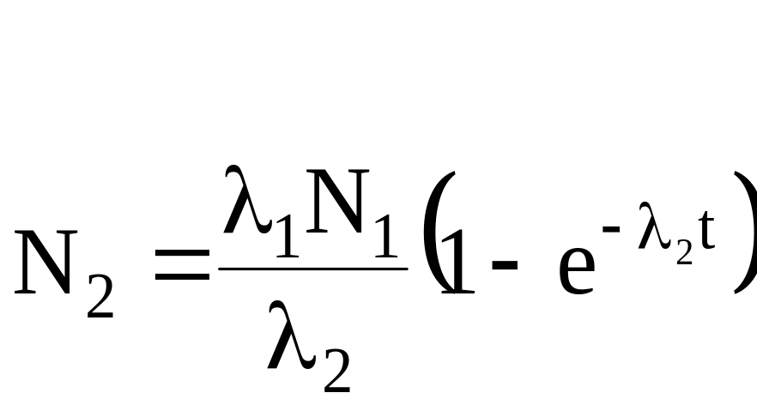
Secular Equilibrium
We have λ₁ << λ₂

Slide 13
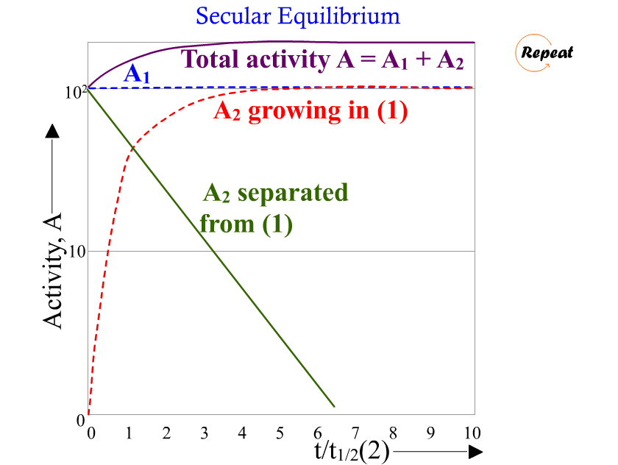

Slide 14
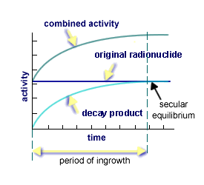
Secular Equilibrium

Slide 15
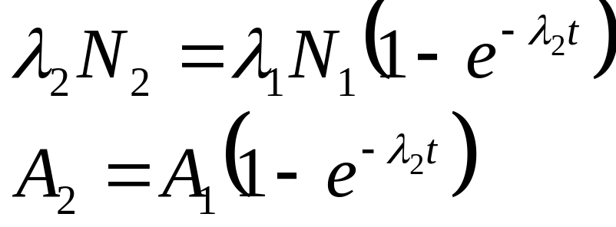
Secular Equilibrium
example: Given that 10 mCi of ²²⁶Ra exists initially in a sample, calculate the activity of its progeny, ²²²Rn after 7 days of decay.

Slide 16
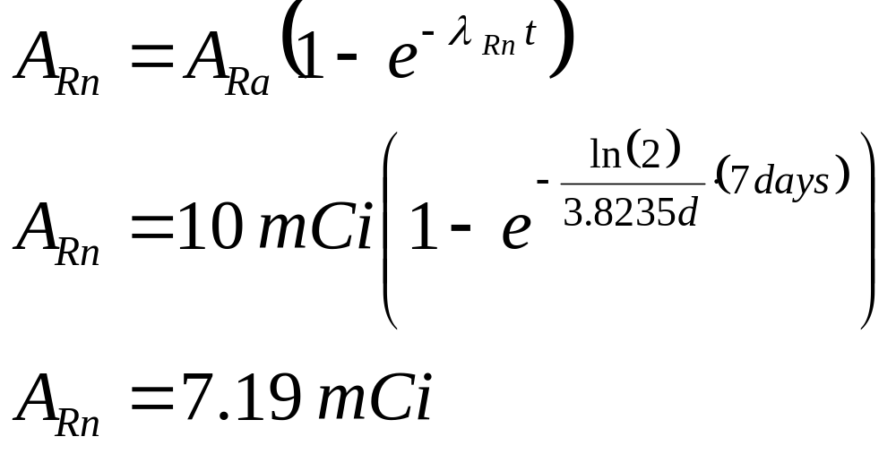
Secular Equilibrium

Slide 17
Secular Equilibrium
a rule of thumb is that the daughter radionuclide activity ~equals the parent radionuclide activity after 7 half-lives of the daughter radionuclide.
so, in our previous example, the activity of Rn will equal the activity of Ra after 3.8235d*7=26.8 days.

Slide 18
Parent-Offspring Equilibria
a second case to look at is when the offspring is longer-lived than the parent.
λ₂<λ₁
the activity ratio increases for all times t
example: ^{131m}Te > ¹³¹I

Slide 19
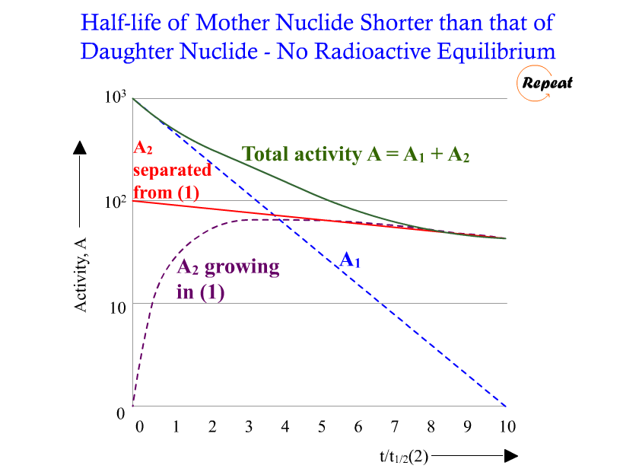

Slide 20
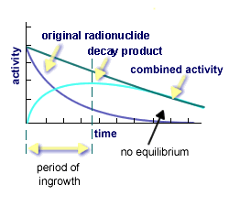
No Equilibrium: T_{½,Off} > T _{½,Par}

Slide 21
Parent-Offspring Equilibria
in the case of no equilibrium, the parent, because of its shorter half-life, decays away.
the total activity of the system does not increase to a maximum as in secular equilibrium; it decreases continuously.

Slide 22
Parent-Offspring Equilibria
the third case to look at is when the parent is longer-lived than the offspring.
λ₁ < λ₂
the activity ratio becomes constant over time.
this equilibrium situation is referred to as transient equilibrium.
example: ⁹⁹Mo > ^{99m}Tc

Slide 23
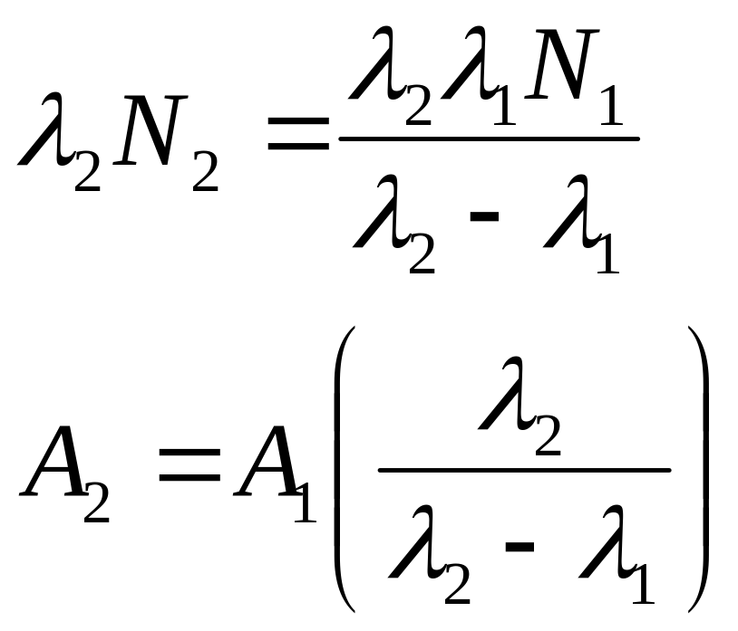
Transient Equilibrium

Slide 24
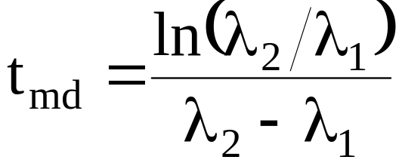
Transient Equilibrium
for an initially pure population of parent atoms, λ₂N₂ = 0 at both t = 0 and t = ∞
consequently, the offspring activity must reach a maximum at some intermediate time, t_{md}:
note: this time also corresponds to the time that the parent and offspring activities are in equilibrium.

Slide 25
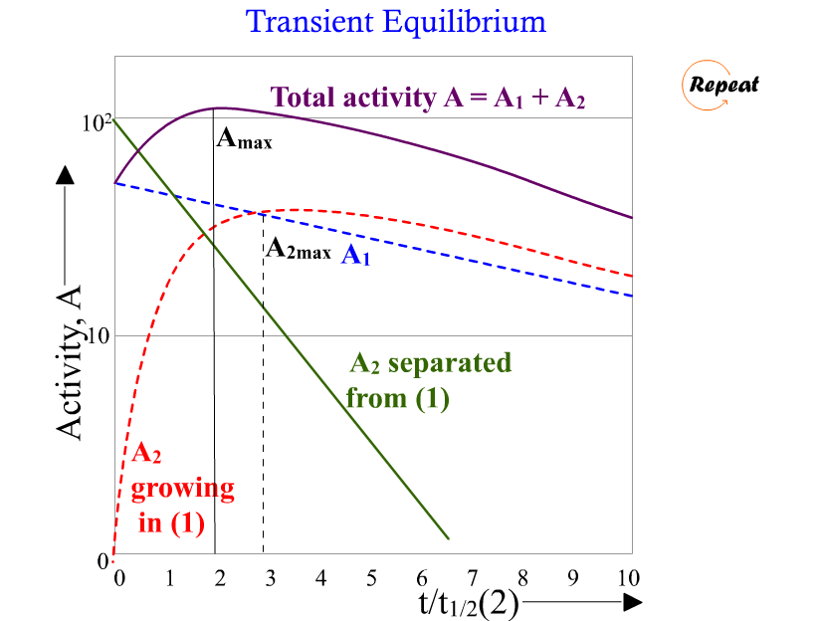

Slide 26
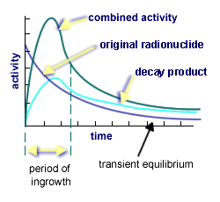
Transient Equilibrium

Slide 27
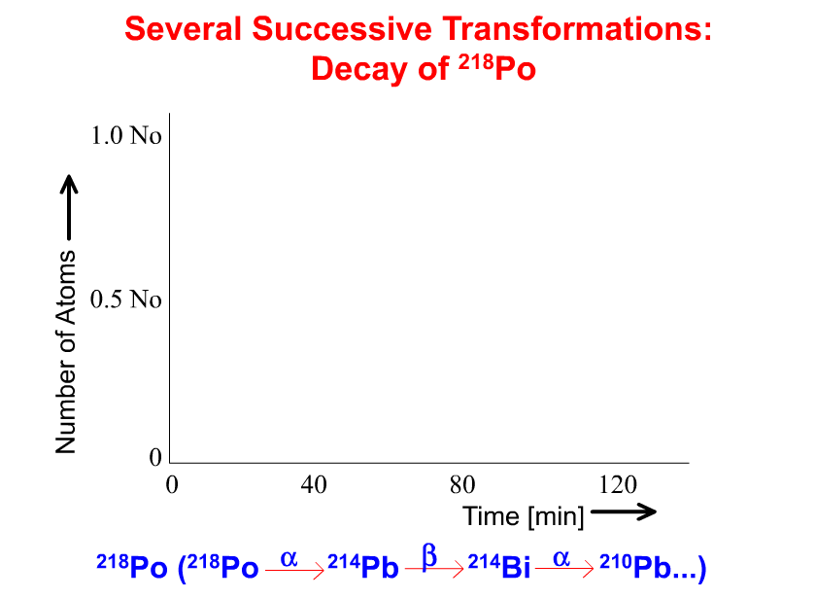

Slide 28
Radioactivity Definitions
1 kilobecquerel (kBq) = 10³ Bq
1 megabecquerel (MBq) = 10⁶ Bq
1 gigabecquerel (GBq) = 10⁹ Bq
1 terabecquerel (TBq) = 10¹² Bq
1 millicurie (mCi) = 10⁻³ Ci
1 microcurie (μCi) = 10⁻⁶ Ci
1 nanocurie (nCi) = 10⁻⁹ Ci
1 picocurie (pCi) = 10⁻¹² Ci
1 femtocurie (fCi) = 10⁻¹⁵ Ci
1 Ci = 3.7 × 10¹⁰ Bq

Slide 29
Radioactive Decay
A VERY useful website is
www.nndc.bnl.gov
and
http://atom.kaeri.re.kr/ton/

Slide 30
Example Problems

Slide 31
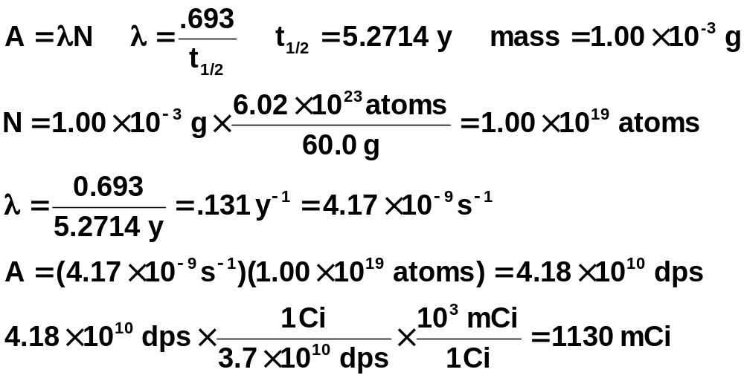
Calculate the activity (in mCi) of a medical ⁶⁰Co source containing 1.00 mg of the isotope.

Slide 32
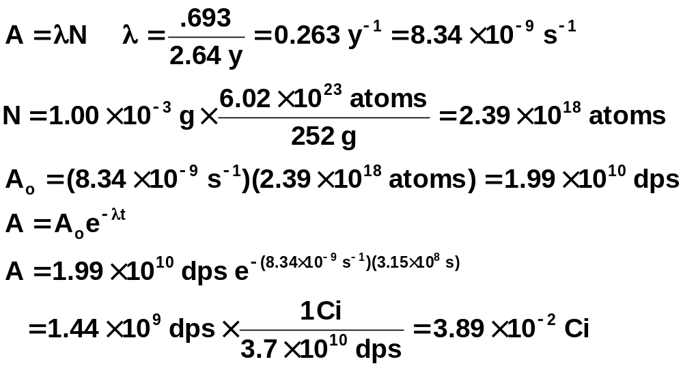
Calculate the activity, in dps and Ci, expected for a 1.00 mg ²⁵²Cf source that is 10.0 years old. The half-life of ²⁵²Cf is 2.64 y.

Slide 33
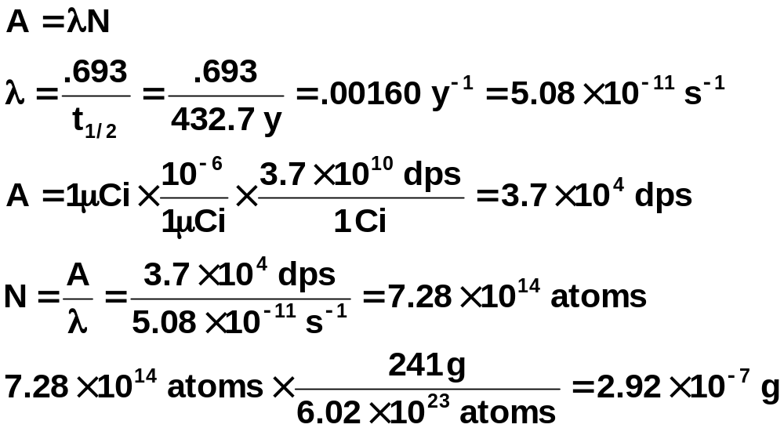
The description of one household smoke detector states that is contains 1 µCi of ²⁴¹Am.
Calculate the mass, in grams, of the ²⁴¹Am present in the smoke detector.

Slide 34
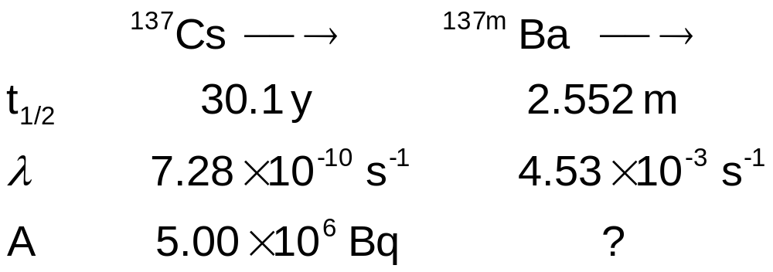
¹³⁷Cs decays via β⁻ emission to ^{137m}Ba. An experiment is begun with 5.00 x 10⁶ Bq of pure ¹³⁷Cs. Calculate the activity due to ^{137m}Ba after a decay period of 50 min.

Slide 35
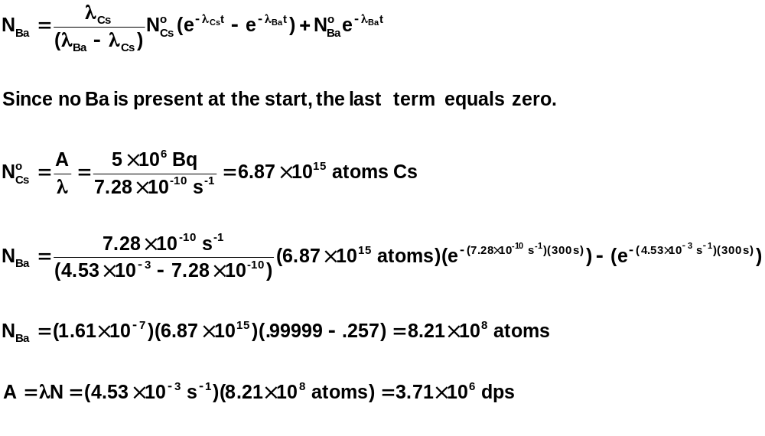

Slide 36
A sample contains a mixture of ²³⁹Pu and ²⁴⁰Pu in unknown proportions. The activity of the mixed sample was found to be 4.35 x 10⁷ dpm for a sample of 0.125 mg of Pu. Calculate the weight % of each Pu isotope present.

Slide 37
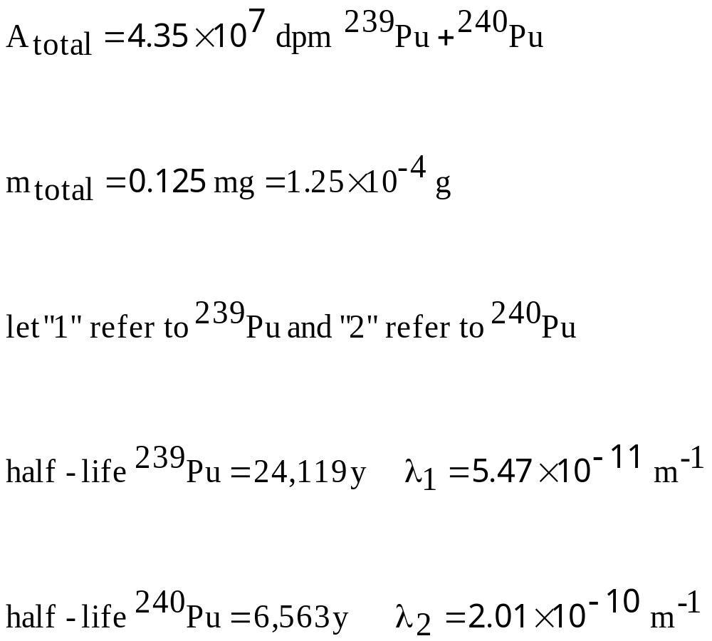

Slide 38
